Slide 1
Employee Salary Prediction
CAPSTONE PROJECT
Presented By:-
Name: Uditya Pal
College: Galgotias University
Department : School of Computer Application and Technology
AICTE ID : STU681252125c6e81746031122

Slide 2
OUTLINE
Problem Statement (Should not include solution)
System Development Approach (Technology Used)
Algorithm & Deployment (Step by Step Procedure)
Result
Conclusion
Future Scope(Optional)
References

Slide 3
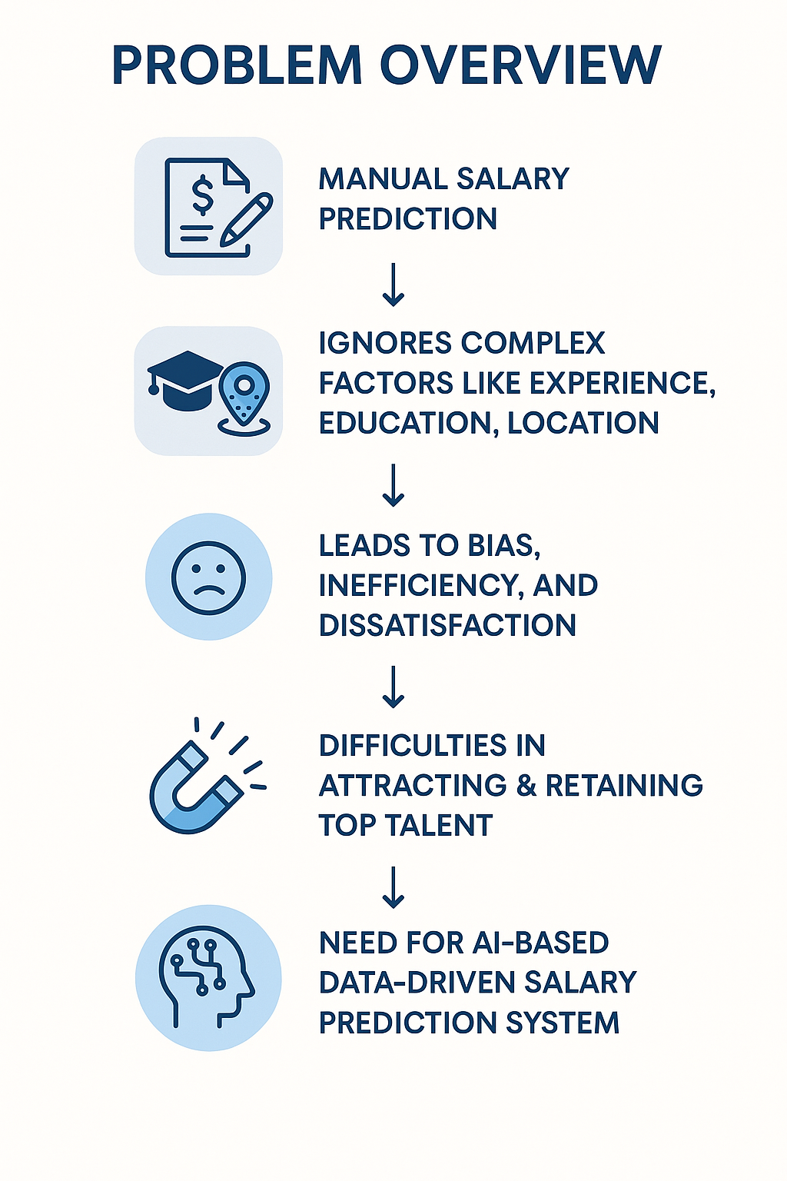
Problem Statement
In today’s competitive job market, determining fair and accurate employee salaries is a critical challenge for organizations. Human Resources teams often rely on manual methods or outdated tools that fail to consider the complex relationships between experience, education, job roles, and other key factors. This lack of data-driven insights can result in unfair compensation, employee dissatisfaction, and talent attrition. Additionally, biases and inefficiencies in the salary prediction process hinder an organization’s ability to attract and retain skilled professionals. To address these challenges, there is a need for an AI-powered system capable of predicting employee salaries with accuracy and transparency.

Slide 4
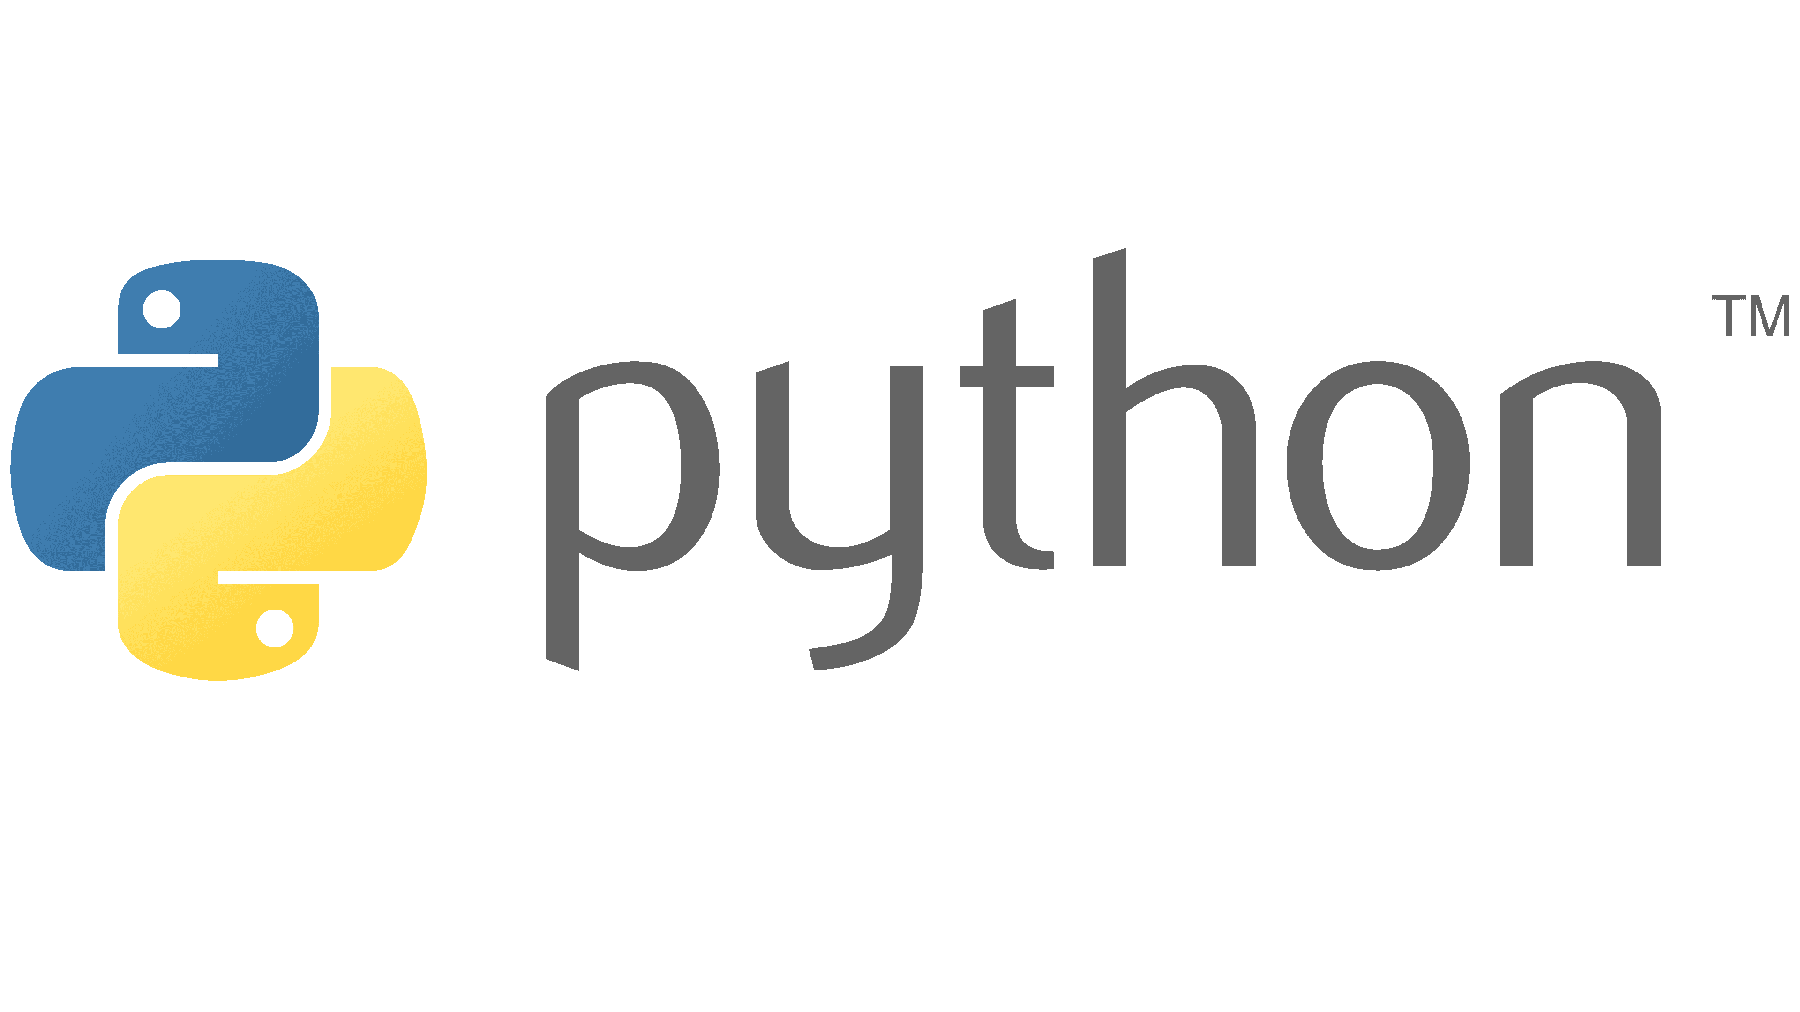
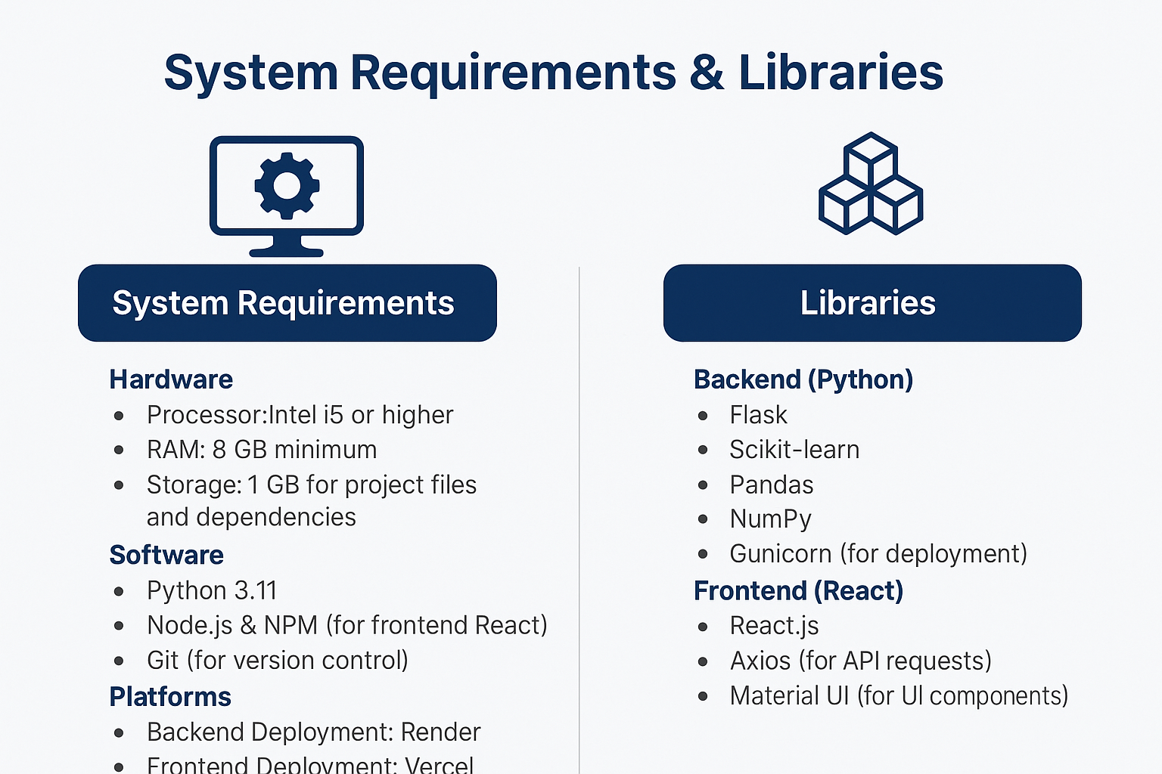







System Approach

Slide 5
Algorithm & Deployment
✅ Algorithm (Model Training)
Used Linear Regression algorithm for predicting salaries based on input features.
Data preprocessing with OneHotEncoder and Pipeline for efficient workflow.
Handled categorical and numerical variables for better model accuracy.
Split dataset into training and testing sets to evaluate performance.
Achieved a good balance between bias and variance to avoid overfitting.
✅ Deployment
Backend developed using Flask to serve predictions via REST API.
Frontend built with React + Vite for a modern and responsive UI.
Connected frontend and backend seamlessly for real-time predictions.
Deployed on Render with separate frontend and backend servers.
Ensured cross-origin resource sharing (CORS) for frontend-backend communication.

Slide 6
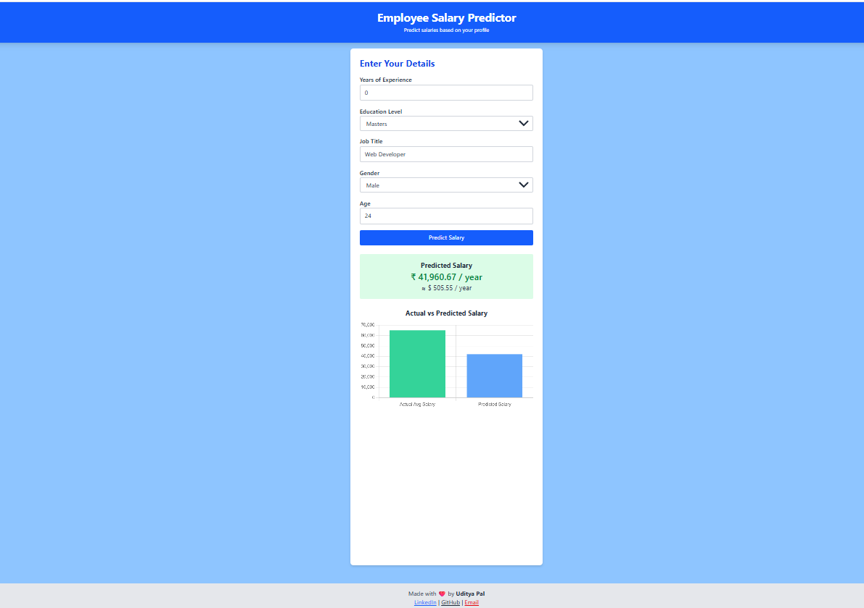
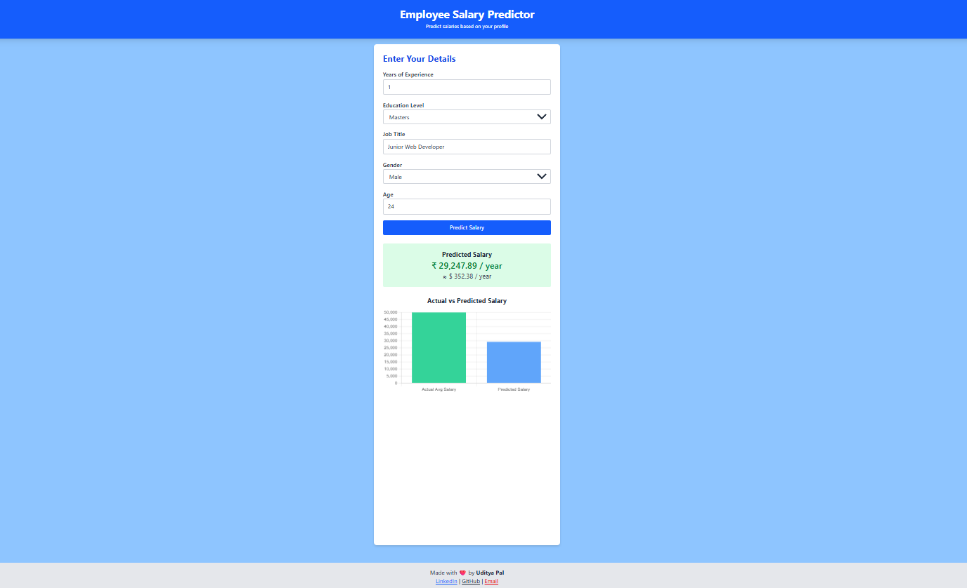
Result

Slide 7
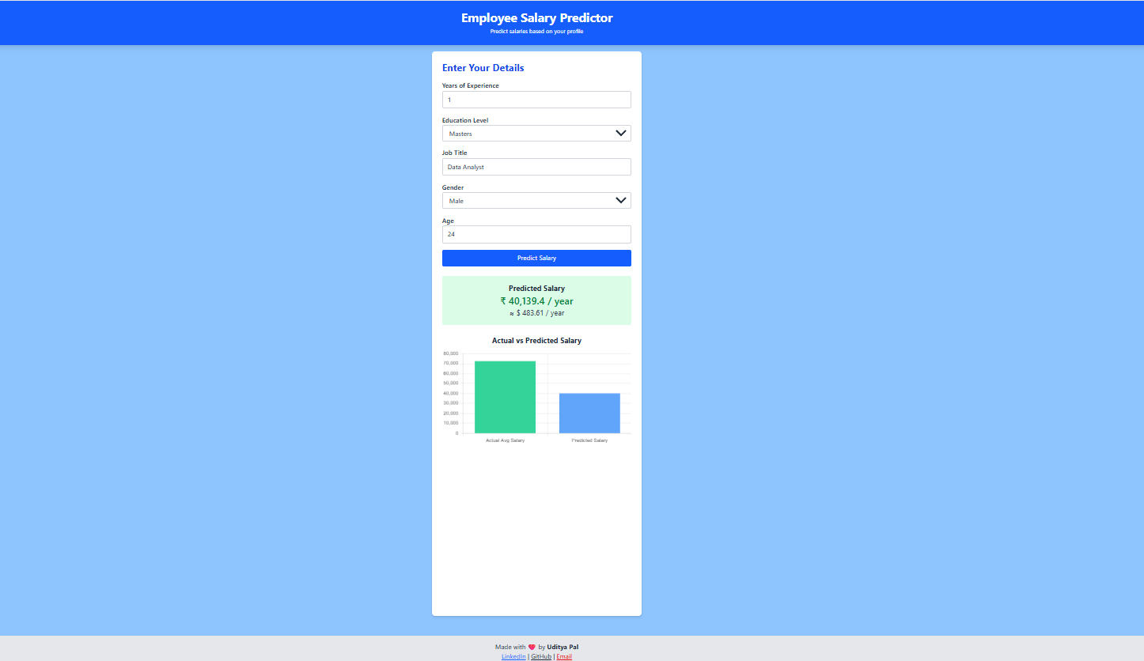
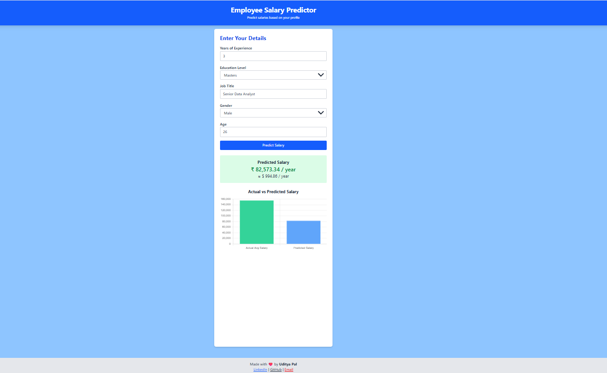

Slide 8
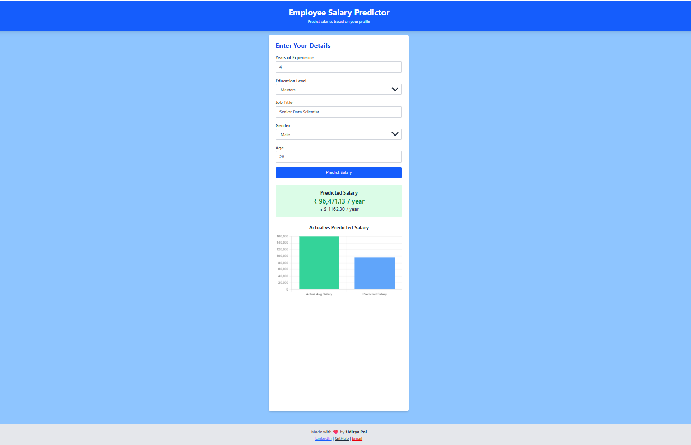
Git-hub Link : https://github.com/Uditya-Pal-1/AI-Salary-Prediction-Model
Deployed Website Link : ai-salary-prediction-model.vercel.app
LinkedIn Link : https://www.linkedin.com/in/udityapal

Slide 9
Conclusion
The system successfully predicts employee salaries based on input features using machine learning.
Deployment of the model enables real-time predictions through a user-friendly web interface.
Achieved accurate results with a lightweight and scalable architecture.
Faced challenges like version mismatches in libraries during deployment and CORS issues, which were resolved.
Future improvements include using advanced algorithms (e.g., Random Forest) and deploying on cloud-native platforms for higher scalability.

Slide 10
Future scope(Optional)
Integrate advanced machine learning models like Random Forest or Gradient Boosting for improved accuracy.
Incorporate real-time data streams to handle dynamic salary prediction scenarios.
Expand the system to predict additional HR analytics metrics (e.g., employee retention, attrition risk).
Deploy the application using cloud-native architectures (AWS, Azure) for higher scalability and reliability.
Enhance the user interface with interactive dashboards and visualization tools for HR managers.

Slide 11
References
✅ Research Papers & Articles:
A Study on Salary Prediction using Machine Learning Techniques
Employee Attrition and Salary Prediction using ML
Predicting Salaries with Linear Regression
Deploying Machine Learning Models using Flask and Gunicorn
Scikit-learn Documentation on Pipelines and Serialization

Slide 12
THANK YOU

